Slide 1
Video 1: Limitations of Relational Databases
Agenda:
Limitations of Structure
Limitations of Storage
Limitations of Standard Data Types
Indian Bank Story
In order to appreciate why and how database-alternatives may make sense in the data landscape, we need to understand the short-comings of a relational database. In this segment we discuss the limitations of a RDBS related to structure, storage, and standards.

Slide 2
Data Storage Landscape
Operational Needs
Analytical Needs
Transactional Databases
Data Warehouses
Relational Databases
Data Lakes
Non-Relational Technologies
Alternative Data Stores

Slide 3
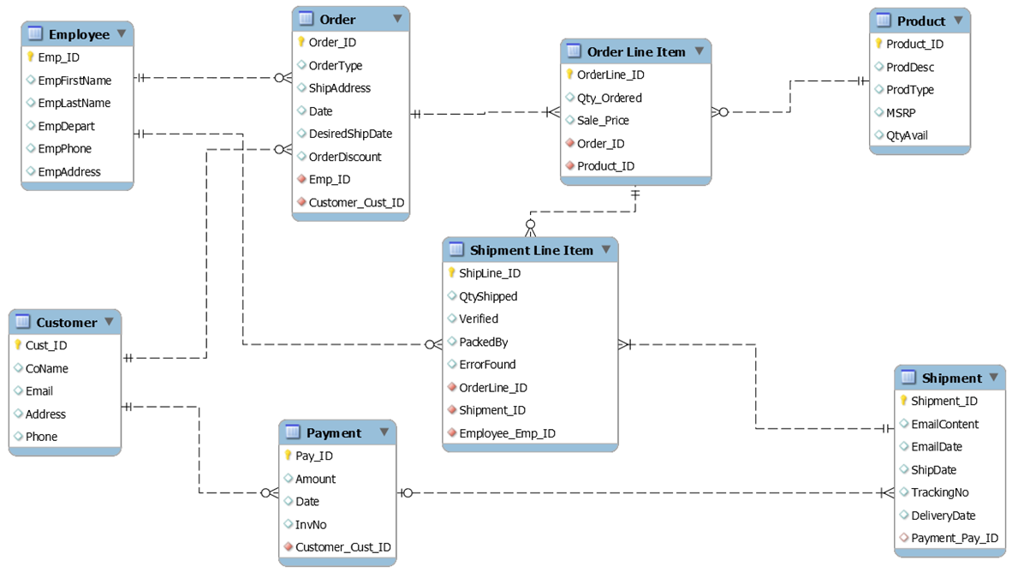
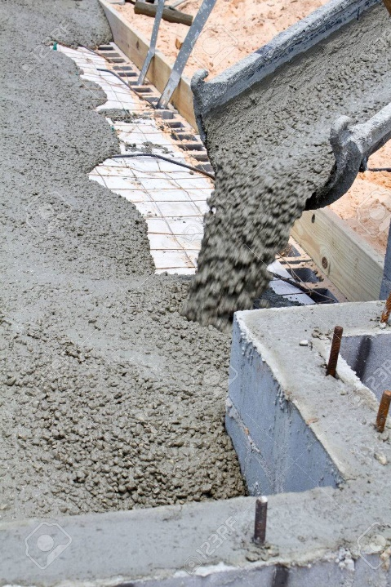

Relational Databases: Cost of Structure
Limited Flexibility
A Priori Design
Notes:
Two-sided coin, really…this is also what makes it great. It’s optimized. It’s easy to know what you have and the structure allows you control. It’s relatively clean and transformed. But there are some downsides…you have to know the structure in advance – you’re designing something for your data to come and live in. Even on a good day that’s hard to do. Further, changes aren’t easy.

Slide 4
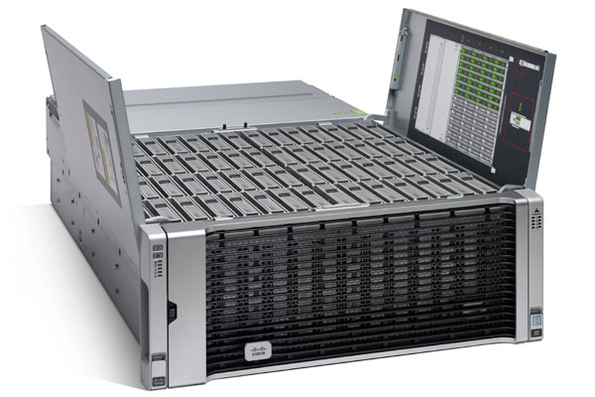

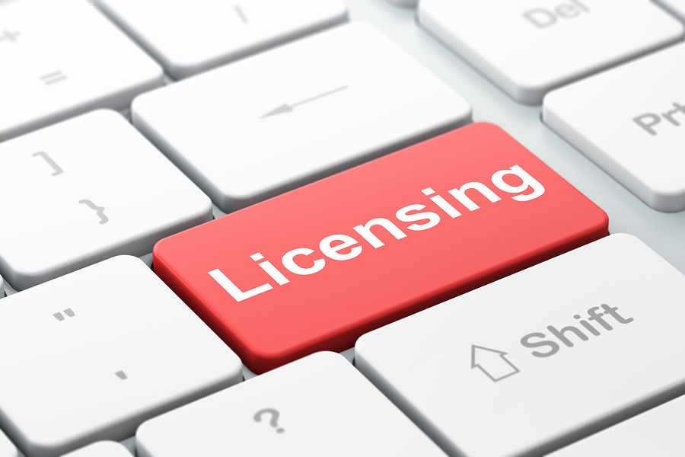
Relational Databases: Cost of Storage
Often Expensive
Especially as they Grow
Notes:
While the fine print on most RDBS vendors has very large limits regarding the size of a database solution, the reality is you have to be able to support that data storage. Relatively speaking, RDBS are finicky – they need expensive data storage solutions in order to run in the organized way that they run and maintain a single truth of the data.
In addition to that…many relational database situations are paying licensing fees to RDBS vendors, that may increase with larger database solutions.

Slide 5
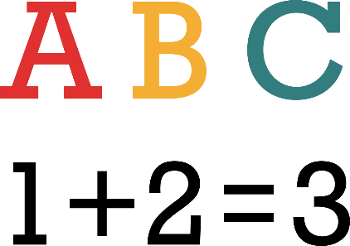

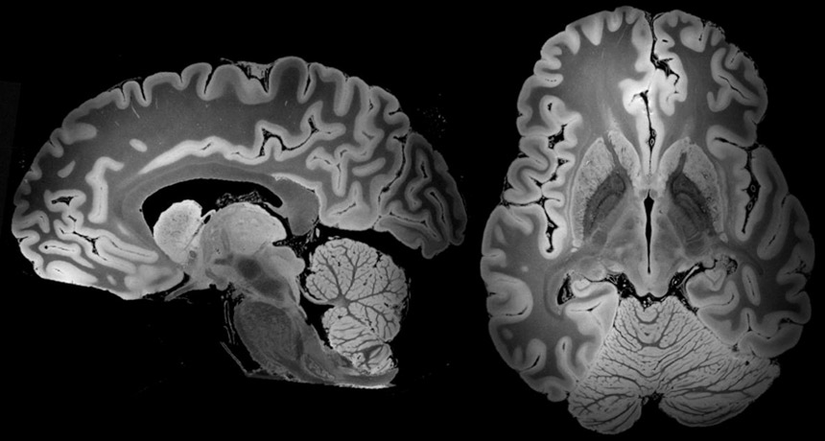

Relational Databases: Cost of Standard
Problematic to Store Other File Types
Notes:
Databases are great at capturing transactions, especially financial transactions. If you need to keep up with lists of customers, addresses, dates…they’re really good at that too. However, they’re not so great at other forms of data…like PDFs, images, other media files.

Slide 6
Video 2: The Power of Distributed DAta
Agenda:
Traditional Data Storage
Distributed Data Storage
Benefit 1: Redundancy
Benefit 2: Cost
Data lakes allow you to separate computing and data storage, and they do this by leveraging distributed data techniques. In this segment, we describe (at a high level) what distributed data means and the major benefits it yields.

Slide 7
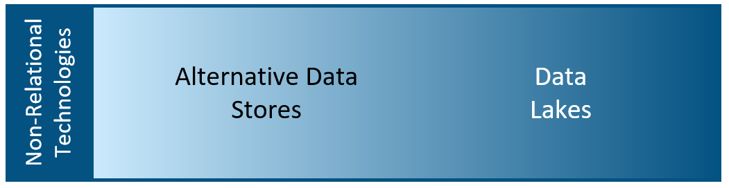



Benefit of Going “Non-Relational”
Data Storage
Processing
S
E
P
A
R
A
T
E

Slide 8
Relational Database Storage
Data
Organized pieces of data…
Data
Big Data = Running Out of Space!!
Relational Database Solution

Slide 9
Data Storage
Data
Spread this out and share the load between computers!
Organized pieces of data…

Slide 10
Distributed Data Storage
Data piece broken down into uniform blocks…
“Nodes” or multiple storage locations (i.e., multiple servers!)

Slide 11
Distributed Data Storage
Replicating and placing on multiple nodes…
“Nodes” or multiple storage locations (i.e., multiple servers!)

Slide 12
Distributed Data Storage
Blocks are replicated and spread uniformly
“Nodes” or multiple storage locations (i.e., multiple servers!)

Slide 13
Benefit 1: Reliability
In this example, “N” is 3, because we’ve replicated the data 3 times.
In a distributed data design, you can tolerate “N-1” node failures.
“Nodes” or multiple storage locations (i.e., multiple servers!)

Slide 14
Benefit 2: Hardware Cost
Nodes can be inexpensive commodity hardware….
“Nodes” or multiple storage locations (i.e., multiple servers!)

Slide 15
Commodity Hardware
“Typical Vanilla” Storage Server…
8-16 cores, 16-96GB of RAM, 12-36TB disk
~$3,000 a piece (rough estimate)
Generally, at the same price-point, servers are twice as capable today as they were 3-5 years ago – on every single dimension.
Notes:
You don’t have to buy a faster server. You just have to buy a few more cheap ones.

Slide 16
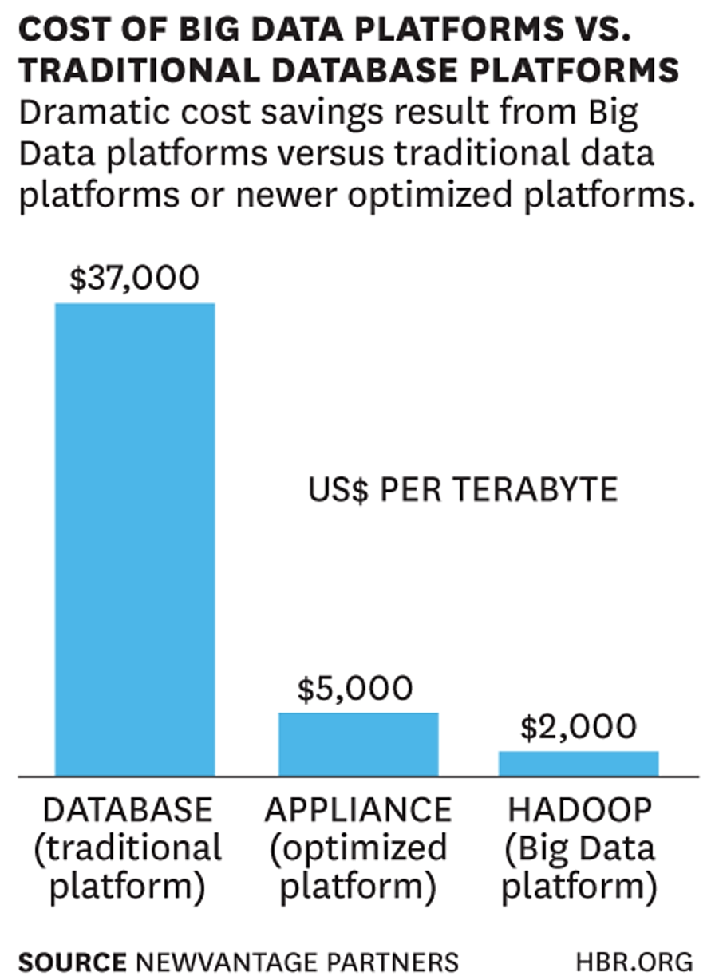
Realizing Cost Savings with Distributed Data
Notes:
You don’t have to buy a faster server. You just have to buy a few more cheap ones.

Slide 17
Video 3: Introduction to Data Lakes
Agenda:
Flexible role of Structure in a Data Lake
How Data Lakes often Complement Data Warehouses
Example Ecosystems
The term “data lake” is an approach to big data architecture that is not constrained by typical, relational database. It separates computing and data storage and it provides more flexibility and lower storage costs. In this video we discuss what data lakes are in more detail.

Slide 18
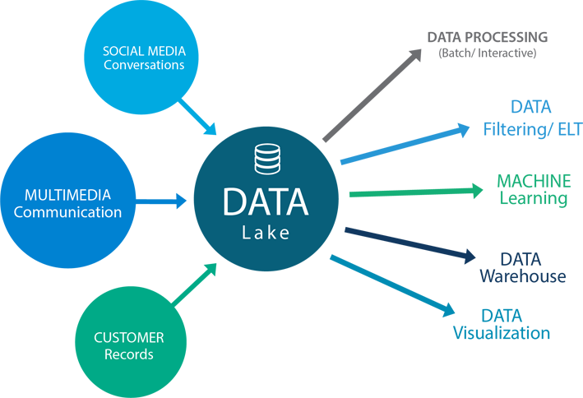
Data Lakes
An approach to big data architecture that separates computing and data storage.
Compared to relational databases, it provides more flexibility and lower storage costs.
One of many possible configurations…
Image from IMGBIN and free for non-commercial use.

Slide 19
Data Storage – Structure not Required
Data lakes can be summarized as “store now, analyze later” (Ori Rafael for Sisense)
Data Lakes do not have the natural structure requirements of a relational database solution.
Some type of structure is still necessary for almost any analyses!
I’ll skip those expensive ETL processes!
You’re only putting off ETL processes until you understand what you have and how to analyze it.

Slide 20

Reality of Structure in a Data Lake
Spectrum of Structure
Raw & Unstructured
Semi-Structured
High Structured
Truths about Structure…
Valuable
Expensive
The same could be said about data quality (cleanliness)
Notes:
Time or money or both…

Slide 21
Data Lake = Data Warehouse 2.0
“I don’t need a data warehouse any more. I have a data lake.”
(Dave Wells Interview)
They absolutely should work together. They’re complementary and architecturally we need to rethink maybe not the data warehouse, but the concept of data warehousing, keeping an inventory of data that is subject-oriented, time-variant, integrated, nonvolatile – the defining characteristics that Inmon set forth years ago for a data warehouse. We need data that has those characteristics.
Now, whether we store it in a separate data store, relationally-modeled, and call it the data warehouse or whether we treat that integrated, subject-oriented, time-variant, nonvolatile set of data as some collection, some subset of the data lake isn’t terribly relevant except from an architectural point of view. Architecturally do I want to place the data warehouse and the data lake side-by-side or do I want to place the data warehouse inside the data lake?
Data Lakes and Data Warehouses are complements!

Slide 22
Data Lake + Data Warehouse Ecosystems
Data Lake
Video examples of some use cases that show different ways to architecturally use a data lake with a database.
Relational Database

Slide 23
Data Lake + Data Warehouse Ecosystems
Data Lake
Analytics Solution
Data Warehouse
The data warehouse and the data lake store different data. We access them both, as needed, for our analyses.

Slide 24
Data Lake + Data Warehouse Ecosystems
Data Lake
Data Warehouse
sub-set
We “land” the data into an unstructured data lake and then once we understand the business need we create the appropriate ETL process to feed it into our data warehouse

Slide 25
Data Lake + Data Warehouse Ecosystems
Other Sources
Other Sources
Other Sources
Data Warehouse
Data Lake
We have a legacy data warehouse but it can be clunky. For performance for some of these projects with broader scope we transfer a sub-set of the warehouse data into the data lake so that we can get to everything we need right out of the lake.

Slide 26
Data Lake + Data Warehouse Ecosystems
Data Lake
Data Marts
Data Marts
Everything we use for analytical needs is in our data lake. We have areas that are heavily structured and provide all the functionality of a traditional data mart. These answer specific business needs for certain groups in our organization.

Slide 27
Video 4: Typical Organization’s Journey to Using Data Lakes
Agenda:
Traditional Data Storage
Distributed Data Storage
Benefit 1: Redundancy
Benefit 2: Cost
Data lakes allow you to separate computing and data storage, and they do this by leveraging distributed data techniques. In this segment, we describe (at a high level) what distributed data means and the major benefits it yields.

Slide 28
The Data Lake Journey
Business and IT leaders have told us they remain overwhelmed by the sheer volume and variety of data at their disposal, the speed at which information is traversing internal and external networks, and the cost of managing all this business intelligence. (McKinsey Report)

Slide 29


Trying to manage data right now…

Slide 30
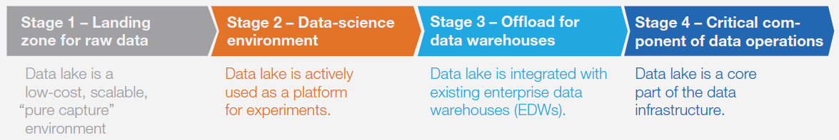
Stages of Data Lake Implementation
Data Lake
Notes:
We know there’s a lot to like about data lakes. We also know there’s a lot of variation in how and why organizations are using data lakes, and there’s a lot of variability about how much structure is involved in any given data lake (or how clean and accurate that data is.) So I want to walk through a set of 4 common stages that companies often find themselves going through when investigating and adopting data lakes into their structure. These are not necessarily sequential…organizations could find themselves standing up a solution that’s in line with say, Stage 1, even though they have a different data lake that’s more in line with a later stage. For reference, this graphic and some of these points are from a McKinsey article which is cited in the slides.

Slide 31
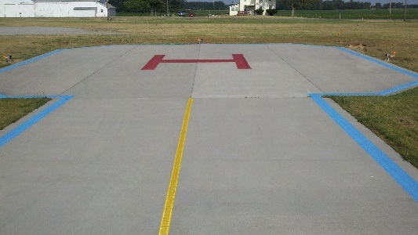
Stage 1: Landing Zone
Architecture: Data lake is built separately from other infrastructure
Motivation: Pure capture…we need a cheap place to park this data.
Structure: Minimal, usually raw format

Slide 32

Stage 2: Analytics Platform
Architecture: Often duplicated data that combines multiple sources in one place.
Motivation: A “test and learn” environment for data scientists and building prototypes of further analytics products.
Structure: Partially structured, usually ad-hoc as projects necessitate it.

Slide 33

Stage 3: Support for Data Warehouse
Architecture: Highly coupled with existing data warehouse solutions and other data sources.
Motivation: Complements a data warehouse in order to ease the cost and space limitations of the legacy systems. Usually the high-intensity tasks remain in a traditional DW, but the DL can catch spill-over cases, especially those involving new data.
Structure: Can vary, but usually approaching high levels of structure due to defined uses.

Slide 34
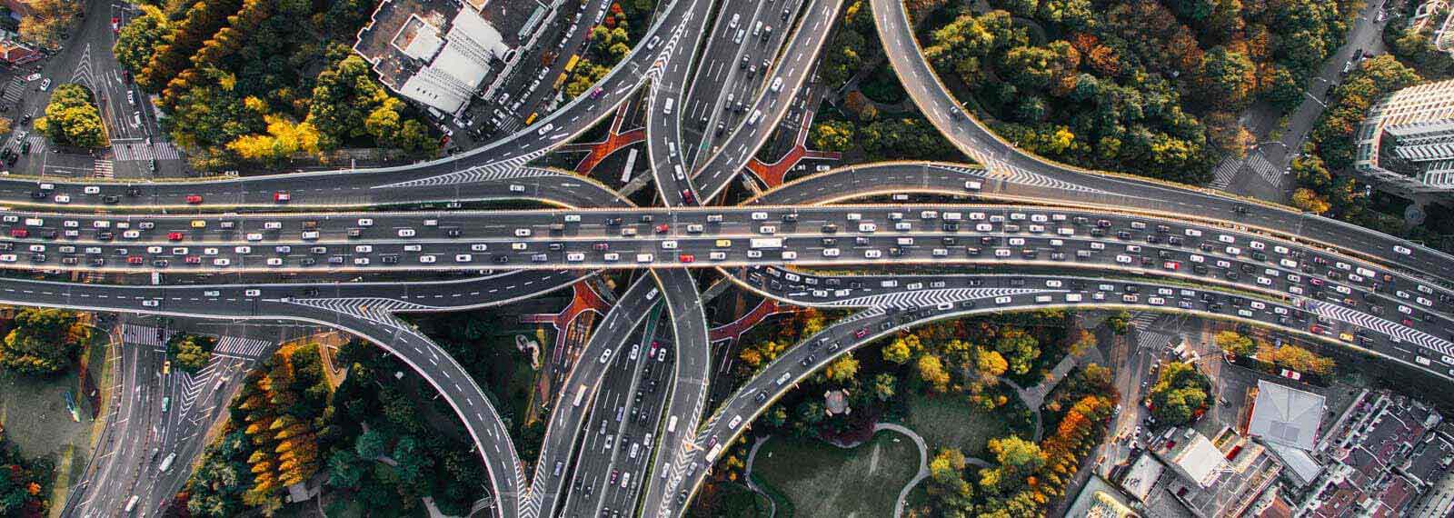
Stage 4: Full Data-as-a-Service Realization
Architecture: The focal point of the data ecosystem, the data lake has replaced many legacy systems.
Motivation: Fully harness the data for current and future analytical needs.
Structure: Highly structured with formal governance rules.

Slide 35
Lessons in Leveraging Data Lakes
Don’t be afraid to crawl before you run…
Find use cases that drive your data lake plan that have real business value
Stop and consider governance decisions
Designate and empower specific individuals to own components of these projects

